Slide 1





STATUS_UPD 9-25-25

Slide 2

Hello!
I am Javier Napoles
Aspiring SOC Analyst
You can find me at @Jnapfx
Notes:
Hi, I’m Javier Napoles. I’m originally from Venezuela, and I’ve been living in Stamford for about five years.
I’m a graphic designer currently transitioning into the field of cybersecurity.

Slide 3
What is a SOC Analyst?
Real time Security Monitoring
SOC analysts continuously monitor network traffic, security alerts, and system logs to detect potential cyber threats in real-time. They serve as the first line of defense, analyzing over 10,000 security alerts daily to identify genuine threats from false positives.
Incident Response & Protection
They respond immediately to security incidents, containing threats, investigating breaches, and implementing recovery procedures. SOC analysts are critical for maintaining organizational security posture and preventing cyber attacks from causing significant damage.
Notes:
A SOC analyst is a cybersecurity professional who monitors networks, systems, and security alerts to detect potential threats in real time. They are the first line of security, analyzing data, investigating suspicious activity, and responding to incidents to protect the organization from cyber attacks.
They respond quickly to security incidents, contain threats, investigate breaches, and carry out recovery procedures. They are essential for keeping the organization safe and preventing cyber attacks from causing serious damage.

Slide 4
Why I chose this career path
Personal Motivation & Background
My background in graphic design has given me a unique perspective on problem-solving and creative thinking. This project combines my passion for technology with my desire to prevent cyber threats and protect organizations from digital attacks.
Creative Problem Solving
Applying design thinking principles to cybersecurity challenges, developing innovative approaches to threat detection and network security architecture for comprehensive protection.
Technical Implementation
Combining analytical skills with hands-on technical expertise to build and deploy effective security monitoring systems and incident response procedures.
Notes:
Personal Motivation & Background
My background in graphic design has given me a unique perspective on problem-solving and creative thinking. This project combines my passion for technology with my desire to prevent cyber threats and protect organizations from digital attacks.
Creative Problem Solving
Applying problem-solving skills to cybersecurity challenges, improving threat detection and network protection.
Technical Implementation
combining analytical skills and hands-on experience to build security monitoring systems and manage incident response.

Slide 5

About my project

Slide 6









Divide & Defend:
“A Hands-On SOC Lab Project with Micro-Segmentation”
Notes:
This project simulates the core responsibilities of a SOC Analyst by building a functional lab environment using virtual machines and open-source tools. It emphasizes practical skills in threat detection, alert triage, and incident response.

Slide 7






Tools used in the Project
Virtualizations & OS Platforms
UTM for virtual machine management and network simulation
Parrot OS as security-focused agents for monitoring
Kali Linux for penetration testing and attack simulation
Detection & Visualization Tools
Wazuh SIEM for comprehensive treat detection and analysis
Grafana for real-time dashboard visualization and monitoring
Discord for automated notification delivery and incident alerts
Notes:
Virtualizations & OS Platforms
UTM for virtual machine management and network simulation
Parrot OS as security-focused agents for monitoring
Kali Linux for penetration testing and attack simulation
Detection & Visualization Tools
Wazuh SIEM for comprehensive treat detection and analysis
Grafana for real-time dashboard visualization and monitoring
Discord is used to send automated notifications and incident alerts to the team.

Slide 8
SOC Implementation Work Process
Design Network Architecture
Install Security Agents
Generate Wazuh Alerts
1
3
5
2
4
6
Deploy Virtual Machines
Simulate Attack Scenarios
Display Grafana Dashboards
Notes:
Network Design – Planned a micro-segmented network to protect critical systems.
Deploy Virtual Machines - Set up virtual machines for different security roles.
Security Agents – Configured Parrot OS agents for monitoring endpoints.
Attack Simulation – Used Kali Linux to test and validate security controls.
Wazuh Alerts – Tuned Wazuh SIEM to detect threats in real time.
Grafana Dashboards – Built dashboards to visualize metrics, incidents, and system health.

Slide 9
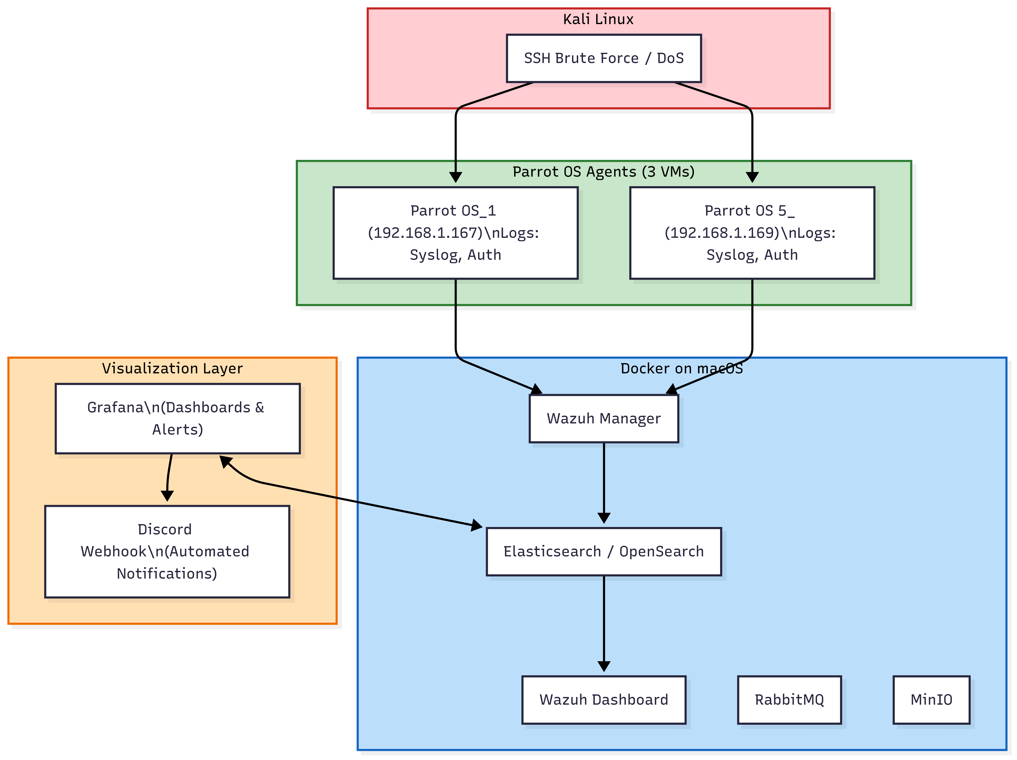
Project Diagram
Notes:
Parrot OS Agents → These are the machines generating logs (syslog and auth).
Kali Linux → Represents the attacker launching SSH brute force or DoS attacks.
Docker on macOS → Runs the main Wazuh services:
Wazuh Manager receives logs from the VMs.
Elasticsearch stores and allows querying of events.
Wazuh Dashboard provides a graphical interface to view alerts.
RabbitMQ and MinIO are support components for Wazuh.
Grafana → Connects to Elasticsearch to display real-time dashboards and metrics.
Discord Webhook → Sends automated notifications when critical alerts occur.
In short:
The agents send logs → Wazuh processes them → Elasticsearch stores them → Grafana and the Wazuh Dashboard display them → if critical alerts are detected, they are sent to Discord.

Slide 10
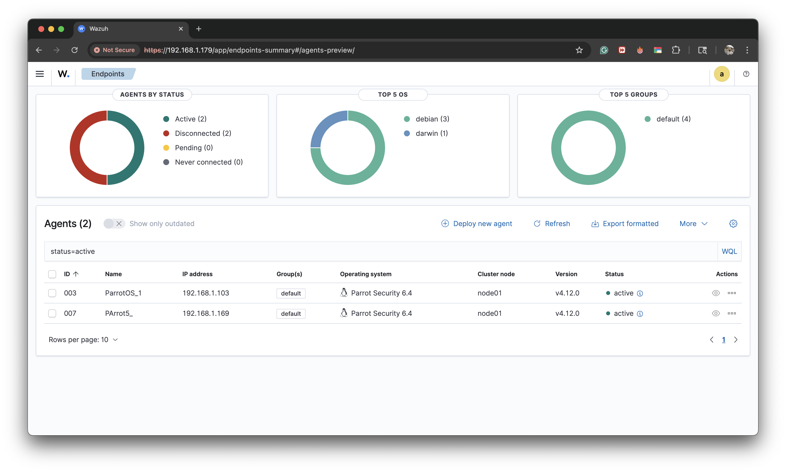
Wazuh Dashboard

Slide 11
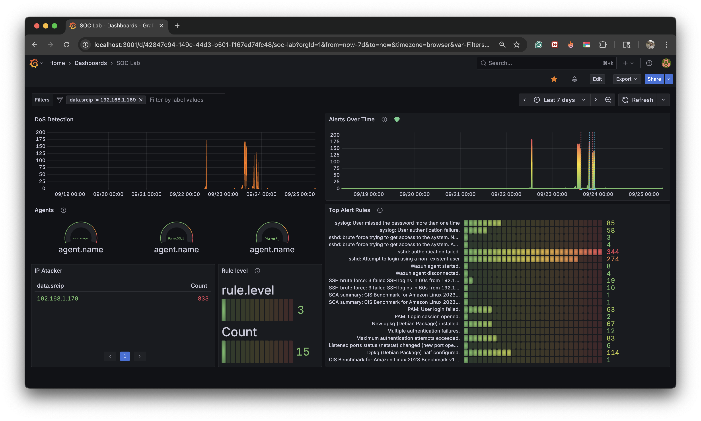
New Technology implemented: Grafana
Real-Time
Dashboard
Incident Timeline
Tracking
Agent Status
Monitoring
Notes:
In this semester we had to pick and learn a new technology that we don’t know Anything about and implemented to out project, so coming from a design background Grafana was an easy pick for me
Why????
Grafana is a tool that turns data into visual graphs and dashboards, making it easy to see trends, metrics, and alerts in real time.
---
Real-Time Dashboards
Grafana provides comprehensive real-time visualization of security metrics, threat indicators, and system performance data for immediate situational awareness.
Incident Timeline Tracking
Advanced timeline visualization shows the progression of security incidents, enabling better forensic analysis and incident response coordination.
Agent Status Monitoring
Comprehensive monitoring of all security agents across the network, ensuring continuous coverage and alerting on any communication failures.

Slide 12
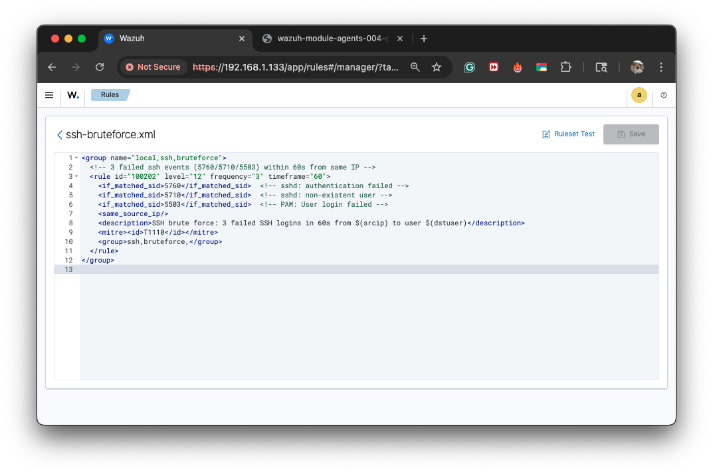
Notes:
Setting up SSH brute force ID
Rule,id: 100202

Slide 13
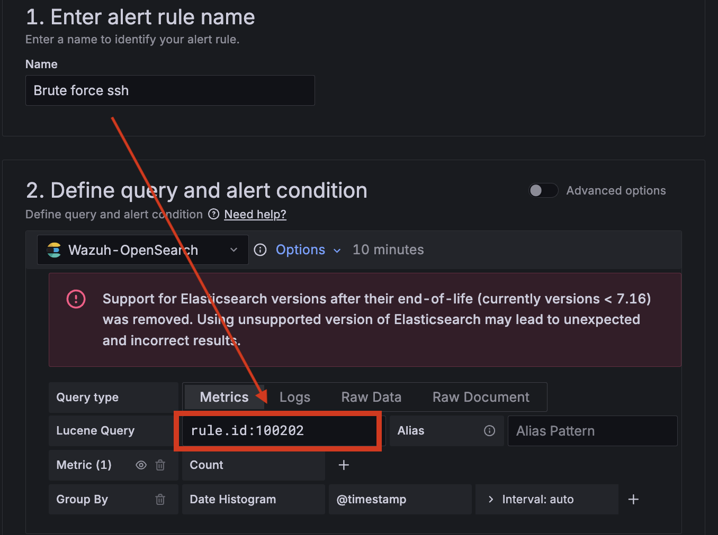
Notes:
SSH RULE Grafana set up
Rule,id: 100202

Slide 14
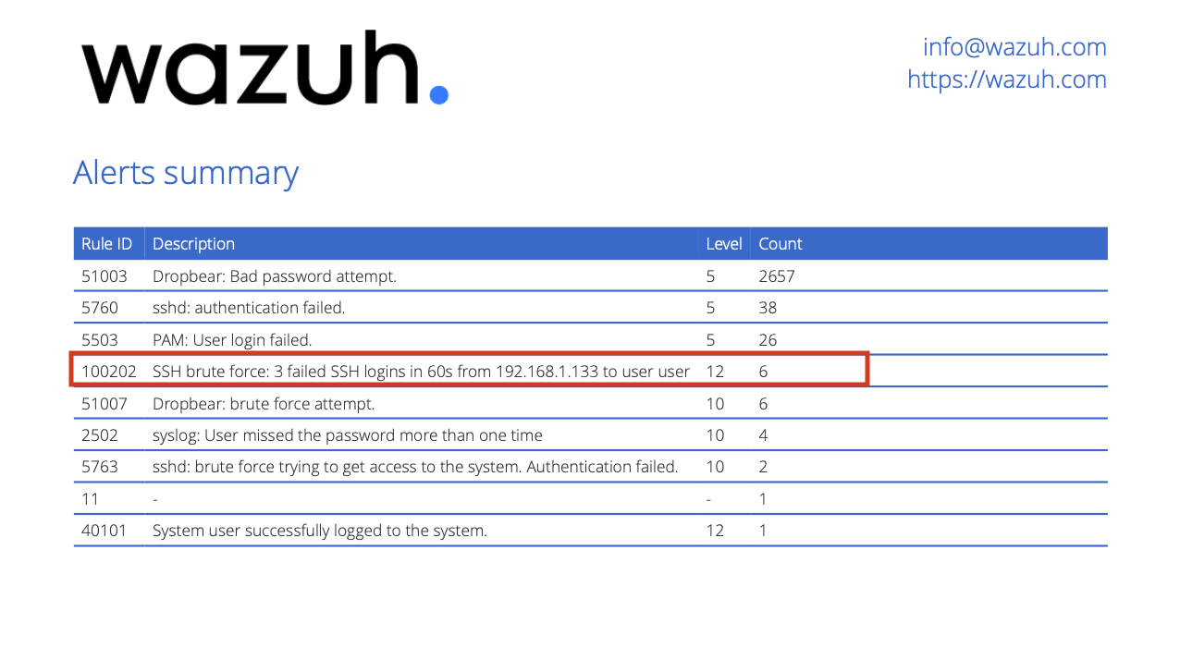

Slide 15
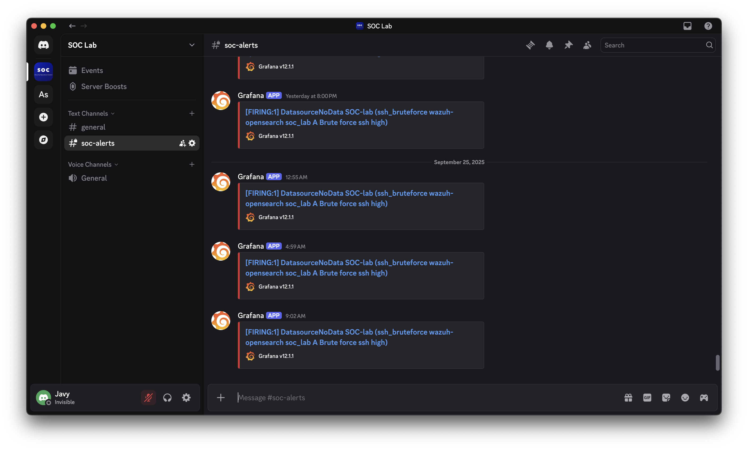
Discord Alerts
Notes:
Discord alerts successfully trigger

Slide 16
Final Results: Mini SOC Achievement
Fully operational SOC
Successfully implemented a complete Mini SOC capable of real-time threat detection, automated alert generation, and comprehensive security monitoring across all network segments.
Advanced Attack Detection
Achieved sophisticated attack detection capabilities using Wazuh SIEM, successfully identifying multiple attack vectors, suspicious activities, and security vulnerabilities during testing phases.
Seamless Tool Integration
Established perfect integration between Grafana visualization platform and Wazuh SIEM, creating a unified security operations environment with automated data correlation and reporting.
Notes:
I successfully built a Mini SOC that can detect threats in real time, generate automated alerts, and monitor security across the network.
I used Wazuh SIEM to detect attacks, identify suspicious activity, and find security vulnerabilities during testing.
integrated Grafana with Wazuh SIEM to create a unified security environment with automated data correlation and reporting.

Slide 17
This project demonstrates how creativity in design thinking can be successfully applied to cybersecurity challenges. The Mini SOC implementation represents a strong foundational step toward building a successful SOC Analyst career, combining technical expertise with innovative problem-solving approaches to create comprehensive security solutions.
Notes:
This project demonstrates how creativity in design thinking can be successfully applied to cybersecurity challenges. The Mini SOC implementation represents a strong foundational step toward building a successful SOC Analyst career, combining technical expertise with innovative problem-solving approaches to create comprehensive security solutions.

Slide 18

2. Extra Resources
Thank You
For Business Plans, Marketing Plans, Project Proposals, Lessons, etc
Javier Napoles | jnapfx@gmail.com

